Slide 1
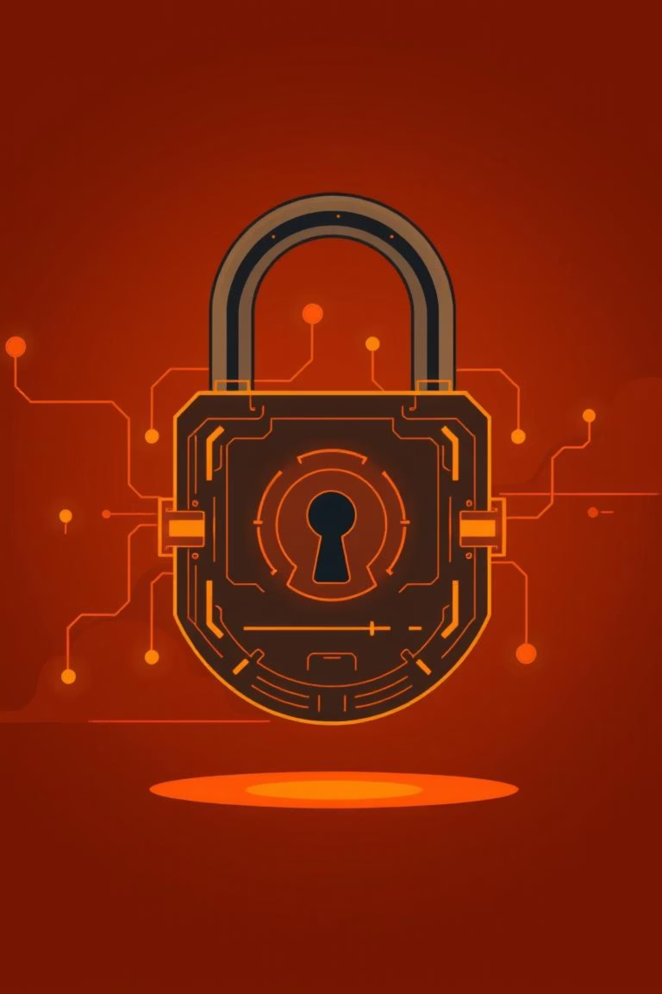
Recognizing Phishing Attacks & Social Engineering: Your First Line of Defense

Slide 2
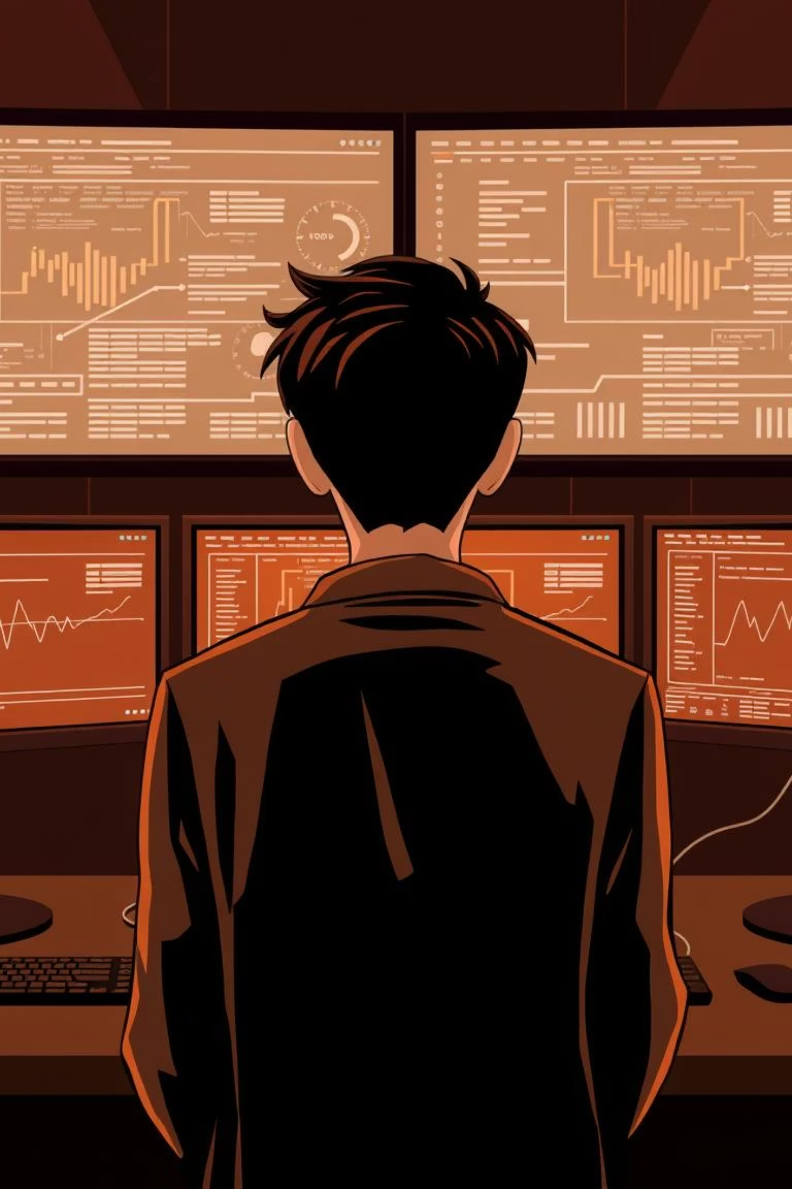



What Is Social Engineering?
Psychological Exploitation
Common Tactics
The art of manipulating people into revealing confidential information or performing unsafe actions, exploiting human psychology rather than technical vulnerabilities.
Often takes the form of phishing emails, vishing (voice phishing) calls, baiting, or pretexting, each designed to trick victims.
Human Element
Social engineering targets the weakest link in security: human trust and susceptibility to influence.

Slide 3

Phishing: The Most Common Social Engineering Attack
Over 3.4 billion phishing emails are sent daily worldwide, making it a pervasive threat.
Phishing is responsible for an alarming 90% of data breaches globally, highlighting its effectiveness for cybercriminals.
Attacks can target various communication channels, including email, websites, social media posts, and text messages.
The goal is always the same: to trick individuals into divulging sensitive data or clicking malicious links.

Slide 4
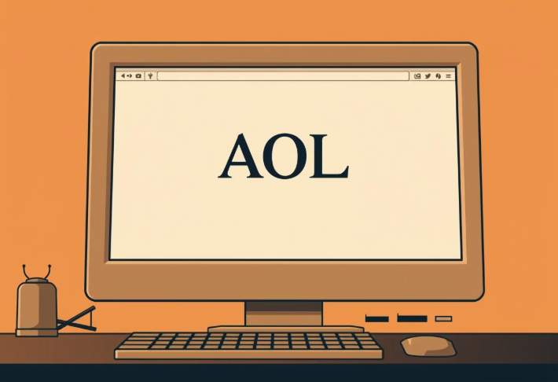

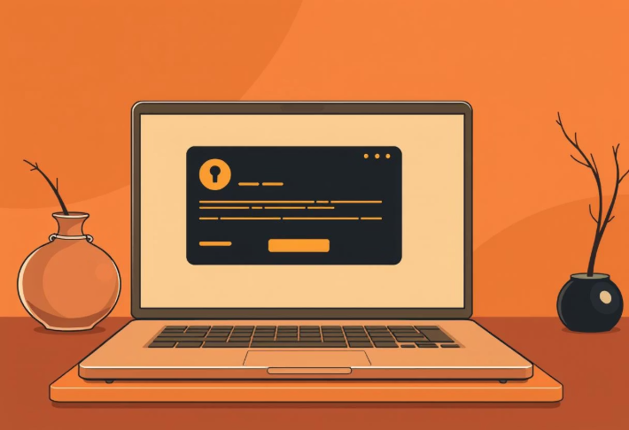
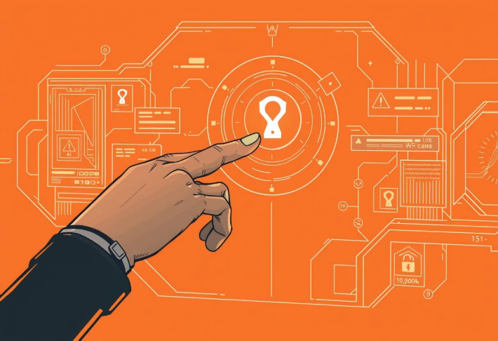
Evolution of Phishing Attacks: From 1995 to Today
1
2
3
4
1995: Early AOL Scams
2001: Spear Phishing Emerges
2010s: Mass-Scale Phishing
2025: AI-Enhanced Phishing
First recorded phishing attacks targeted AOL users with fake URLs (e.g., www.ao1.com) to steal credentials.
More targeted attacks, known as spear phishing, began to focus on stealing credit card information from users of platforms like eBay and banks.
Phishing becomes widespread with sophisticated email campaigns and fake websites mimicking major brands.
The future sees AI generating perfectly crafted, grammar-free, and visually authentic phishing emails, making detection increasingly challenging.

Slide 5
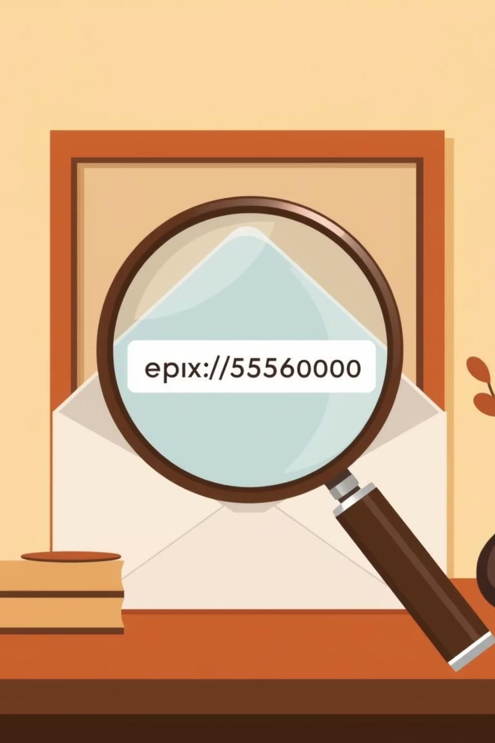
Common Phishing Techniques to Watch For
Link Manipulation
Attackers use misspelled URLs, subdomains, or Unicode tricks (e.g., www.gooogle.com) to deceive users into clicking malicious links.
Fake Credentials
Spoofed SSL certificates and fake login pages are designed to look authentic, tricking you into entering your credentials.
Urgency & Threats
Emails often create a sense of urgency or threaten account closure to pressure recipients into immediate action without thinking.
Impersonation
Messages appearing from trusted contacts or executives (spear phishing, whaling) attempt to leverage authority for malicious requests.

Slide 6
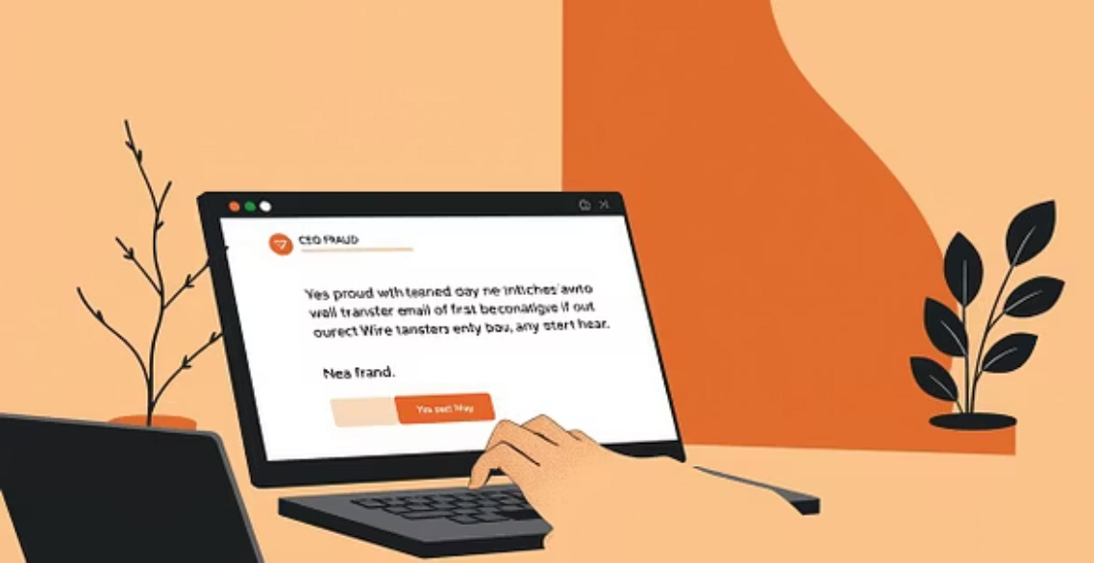
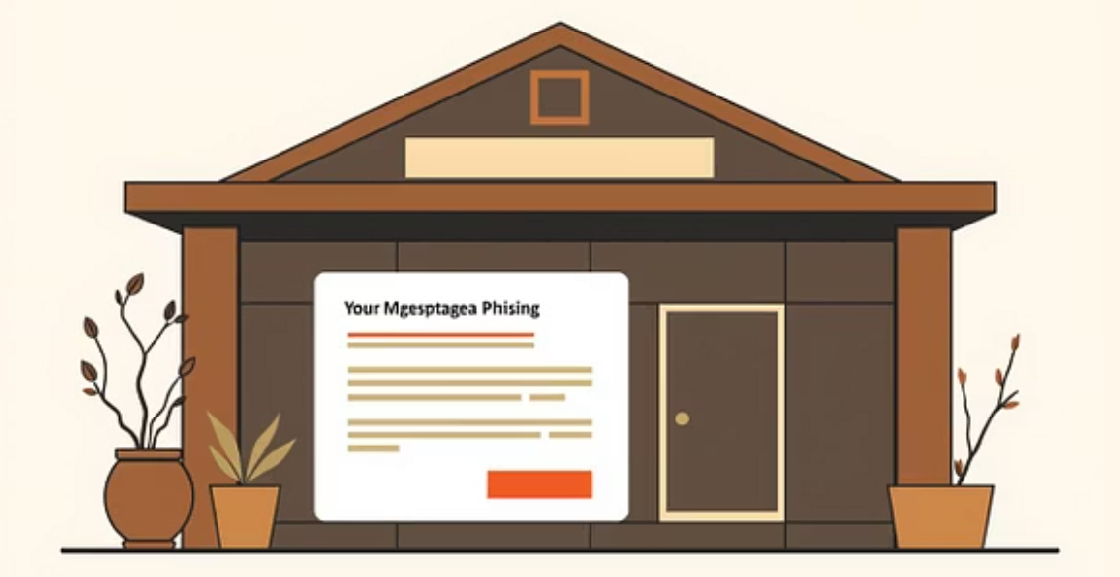
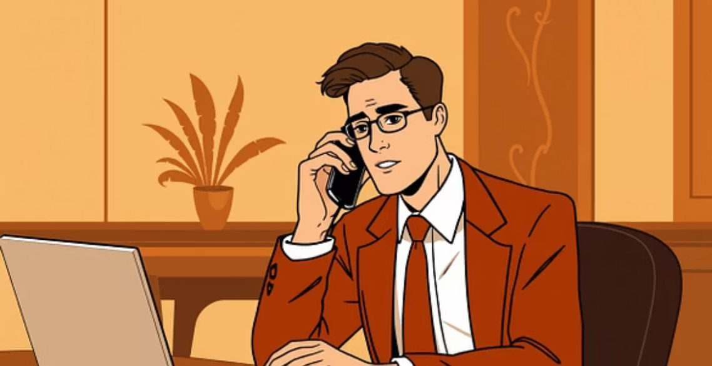

Real-World Examples of Social Engineering Attacks
CEO Fraud: Attackers impersonate executives to request urgent wire transfers, often costing companies millions.
Targeted Spear Phishing: Campaigns targeting specific departments, like mortgage, with fake document requests to steal sensitive data.
Vishing Calls: Impersonating bank officials over the phone to trick individuals into revealing credit card or account information.
Smishing Texts: Malicious links sent via text messages, often disguised as delivery notifications or promotional offers.

Slide 7
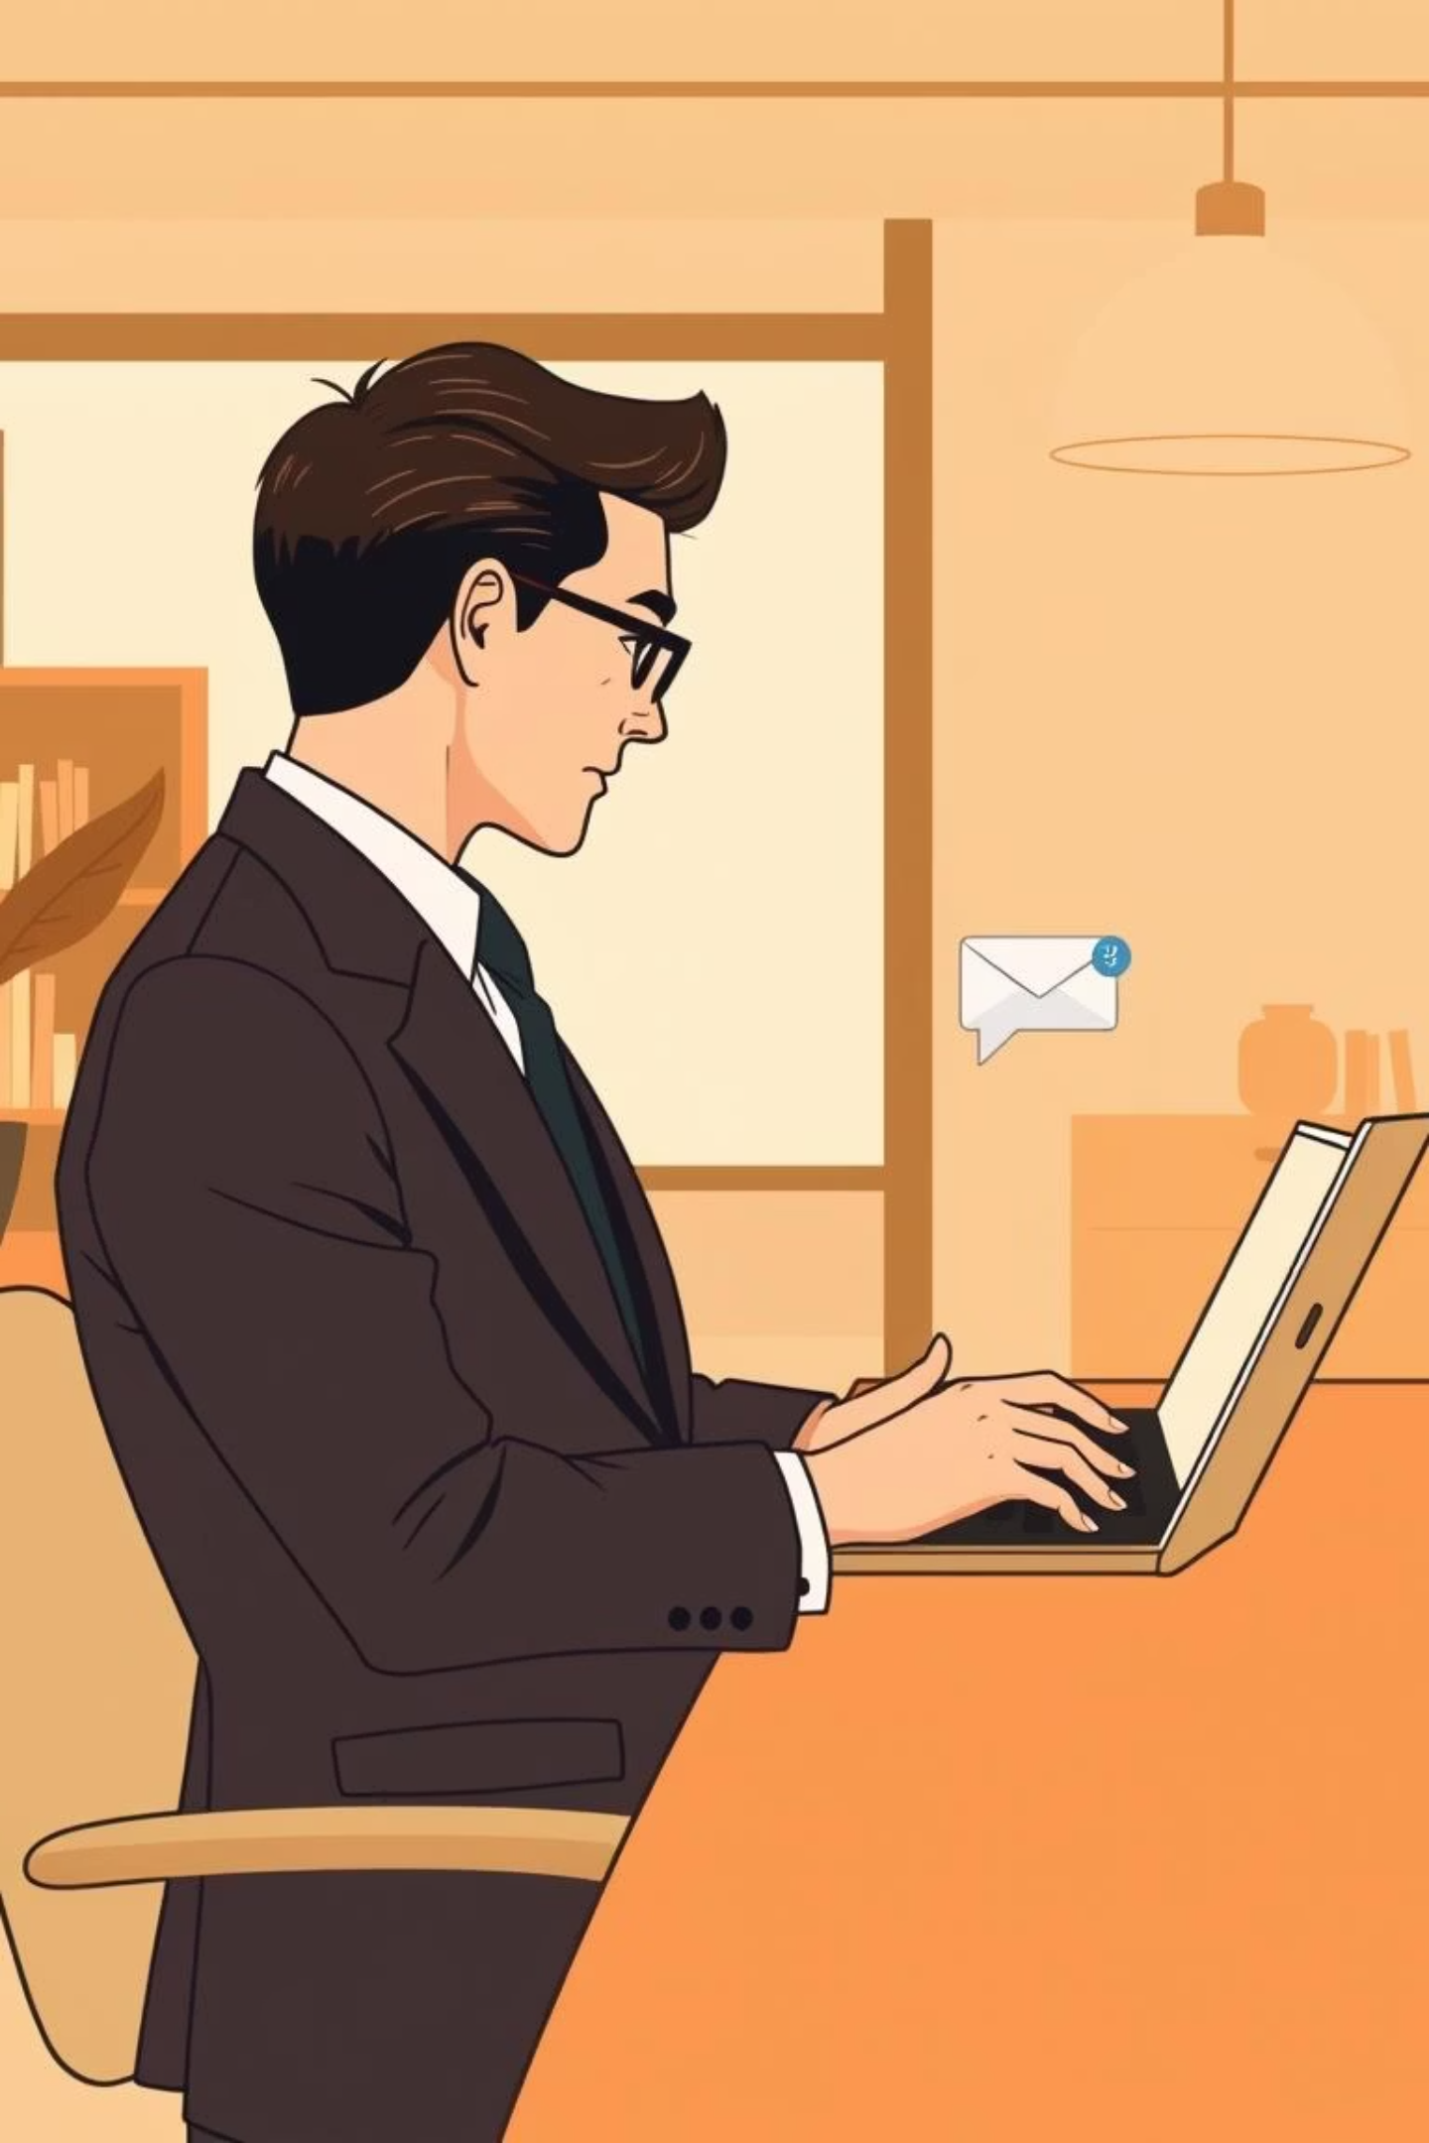



How to Spot a Phishing Attempt
Unexpected Requests
Be wary of unsolicited requests for personal or financial information, especially if they create urgency.
Grammar & Spelling
Poor grammar or spelling errors can be a clue, though modern phishing attempts are increasingly polished.
Hover Over Links
Always hover your mouse over links to preview the actual URL before clicking. Look for discrepancies.
Check Sender's Email
Carefully inspect the sender's email address for subtle differences from legitimate sources.

Slide 8
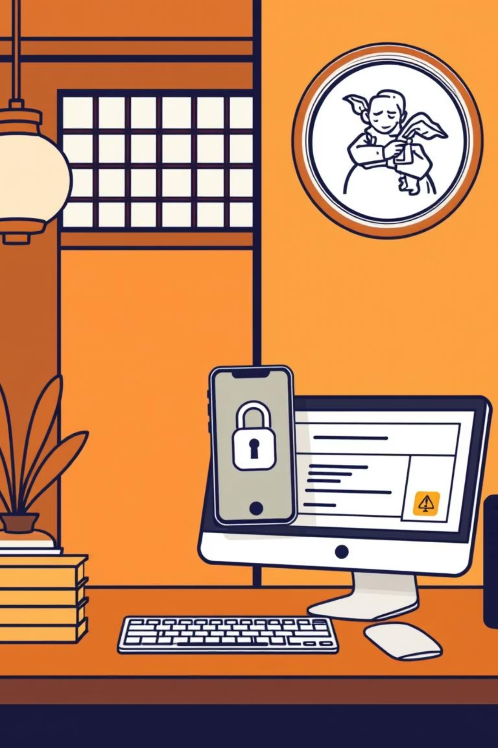
Defending Yourself & Your Organization
1
Never Share Credentials
Never share passwords or sensitive information via email, text, or phone calls, even if the request seems legitimate.
2
Enable Multi-Factor Authentication (MFA)
Use MFA everywhere possible to add an extra layer of security beyond just a password.
3
Keep Software Updated
Ensure all software and devices have automatic updates and patches enabled to protect against known vulnerabilities.
4
Report Suspicious Activity
Immediately report any suspicious emails, calls, or texts to your IT or security team.

Slide 9
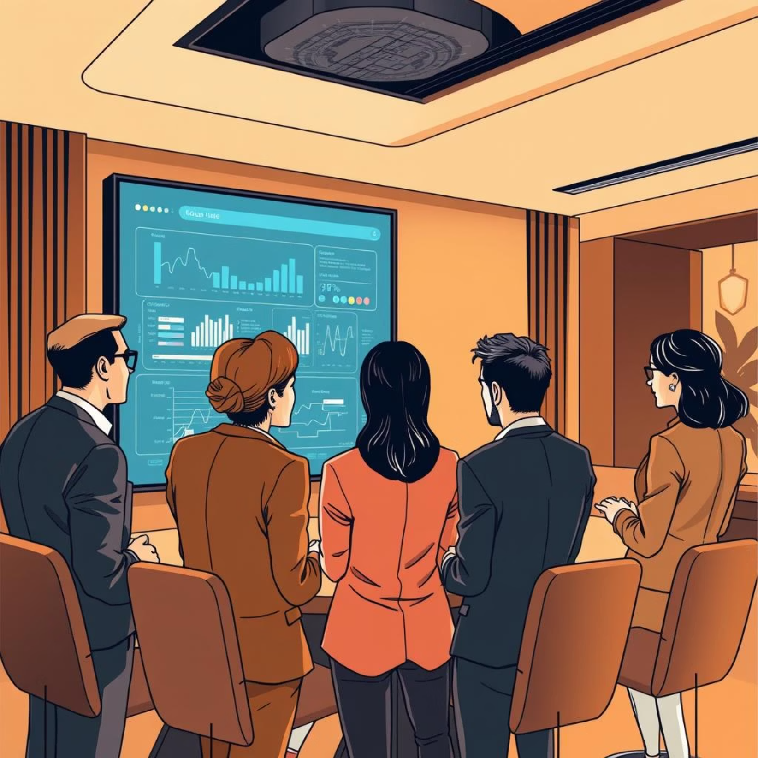
Building a Culture of Cyber Awareness
Regular Training & Simulations: Consistent training and phishing simulations dramatically reduce risk by familiarizing employees with common attack patterns.
Clear Security Policies: Establish clear guidelines for device use, email handling, and incident reporting to ensure a unified defense.
Encourage Skepticism: Foster an environment where employees are encouraged to question and verify requests before acting, especially urgent or unusual ones.
Human Error is a Factor: Remember that 88% of data breaches involve human error; your personal vigilance and adherence to security protocols are crucial.

Slide 10

Your Role in Cybersecurity: Stay Alert, Stay Safe
Evolving Threats
Verify Before Acting
Phishing attacks are constantly evolving, demanding continuous vigilance and updated awareness from everyone.
When in doubt, always verify the authenticity of a request before clicking a link or responding to any message.
Collective Defense
Strongest Link
Together, by staying informed and cautious, we can collectively stop attackers from exploiting trust.
You are the strongest link in your organization's security chain; your awareness is paramount.

